Slide 1
마이크로소프트 팀즈 기초과정
마이크로소프트팀즈 탭 만들기

Slide 2

마이크로소프트 팀즈 탭 만들기
팀즈 탭 만들기 개요
탭 설정과 컨텐츠
팀즈와의 인터랙션
외부서비스와의 인터랙션
데모

Slide 3
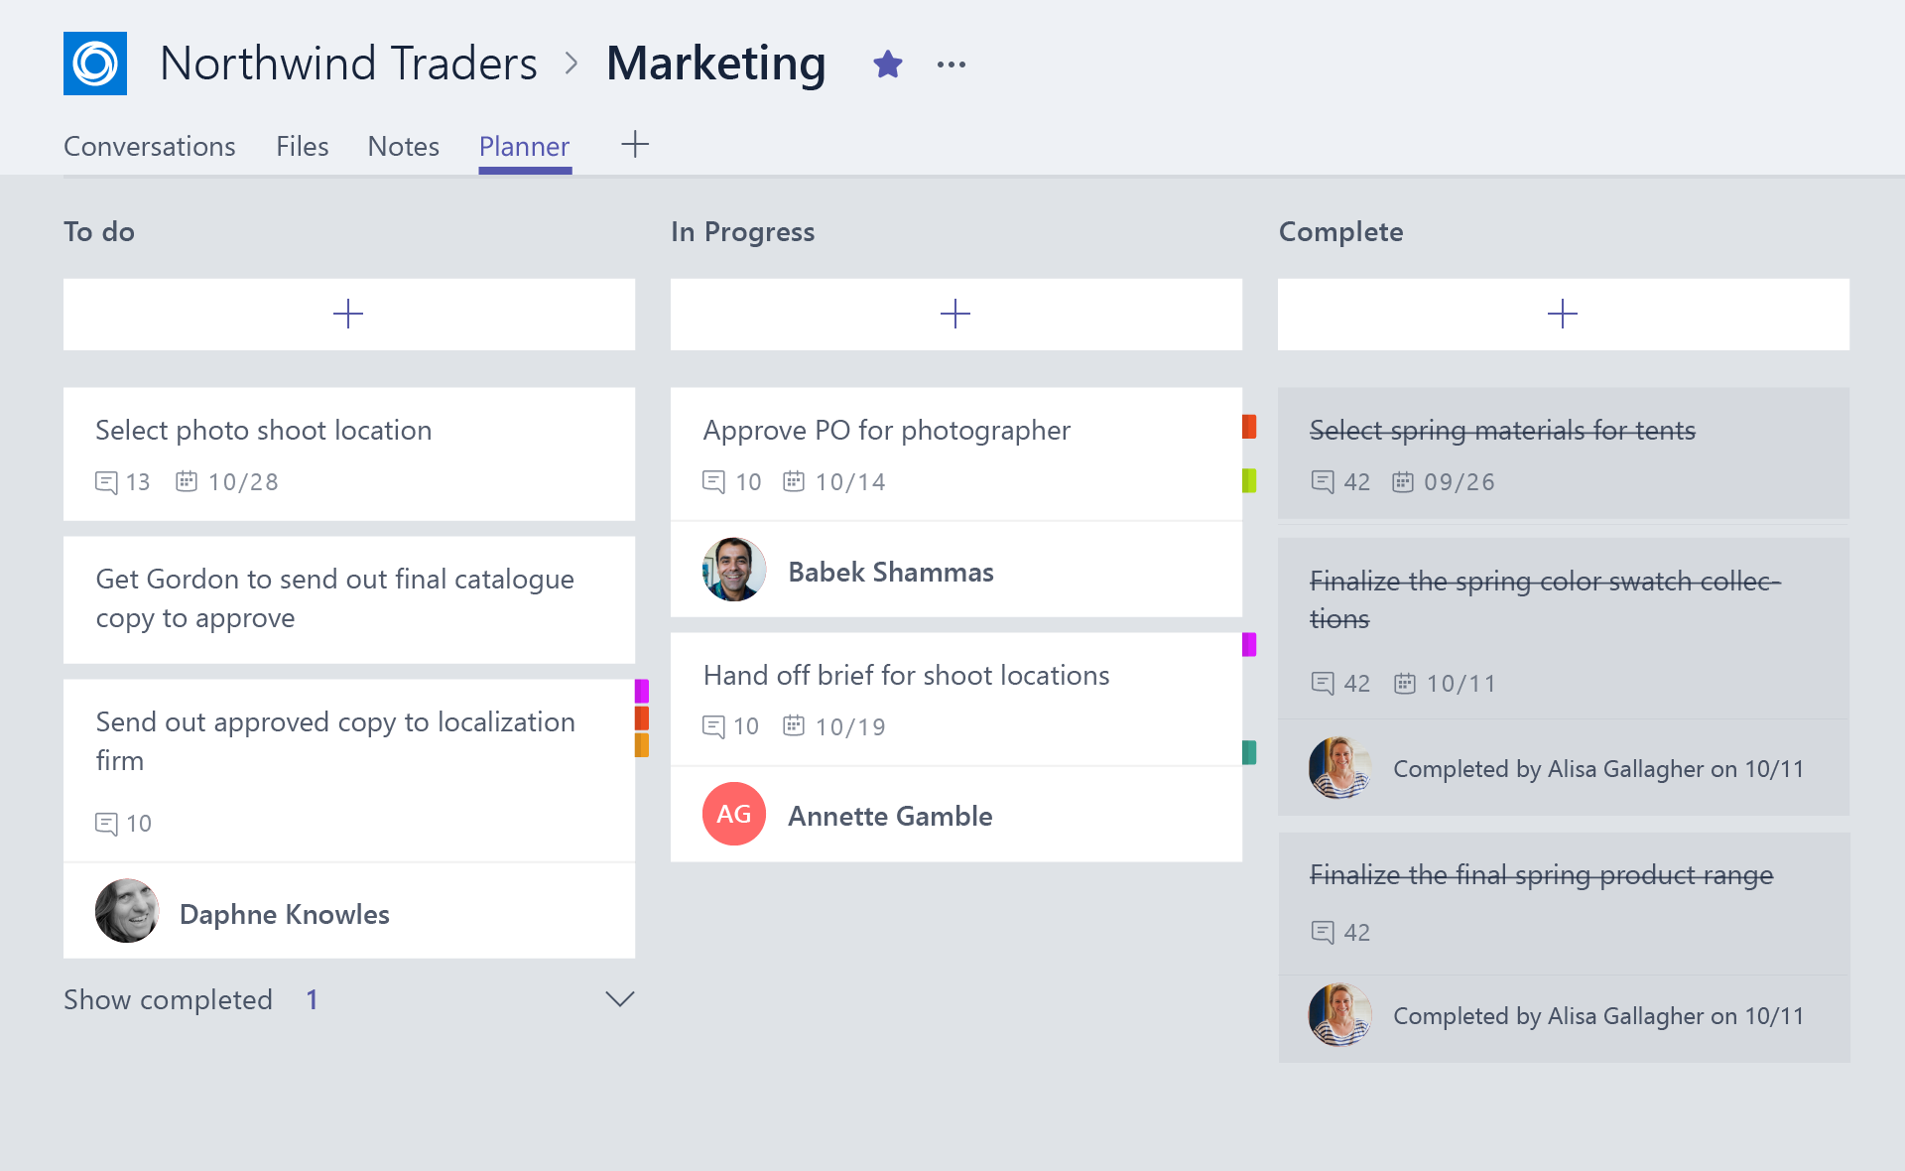
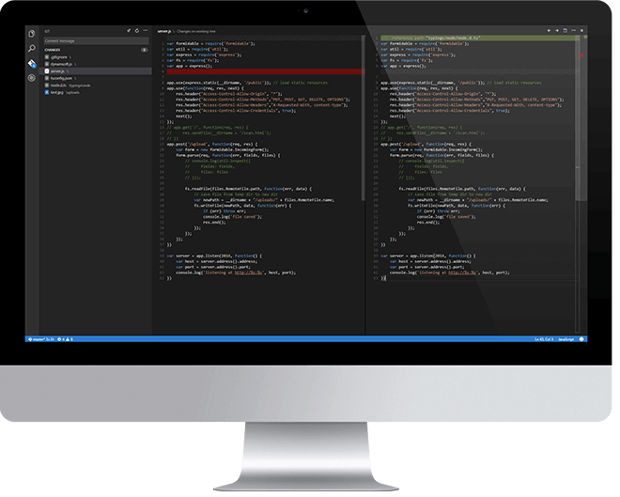
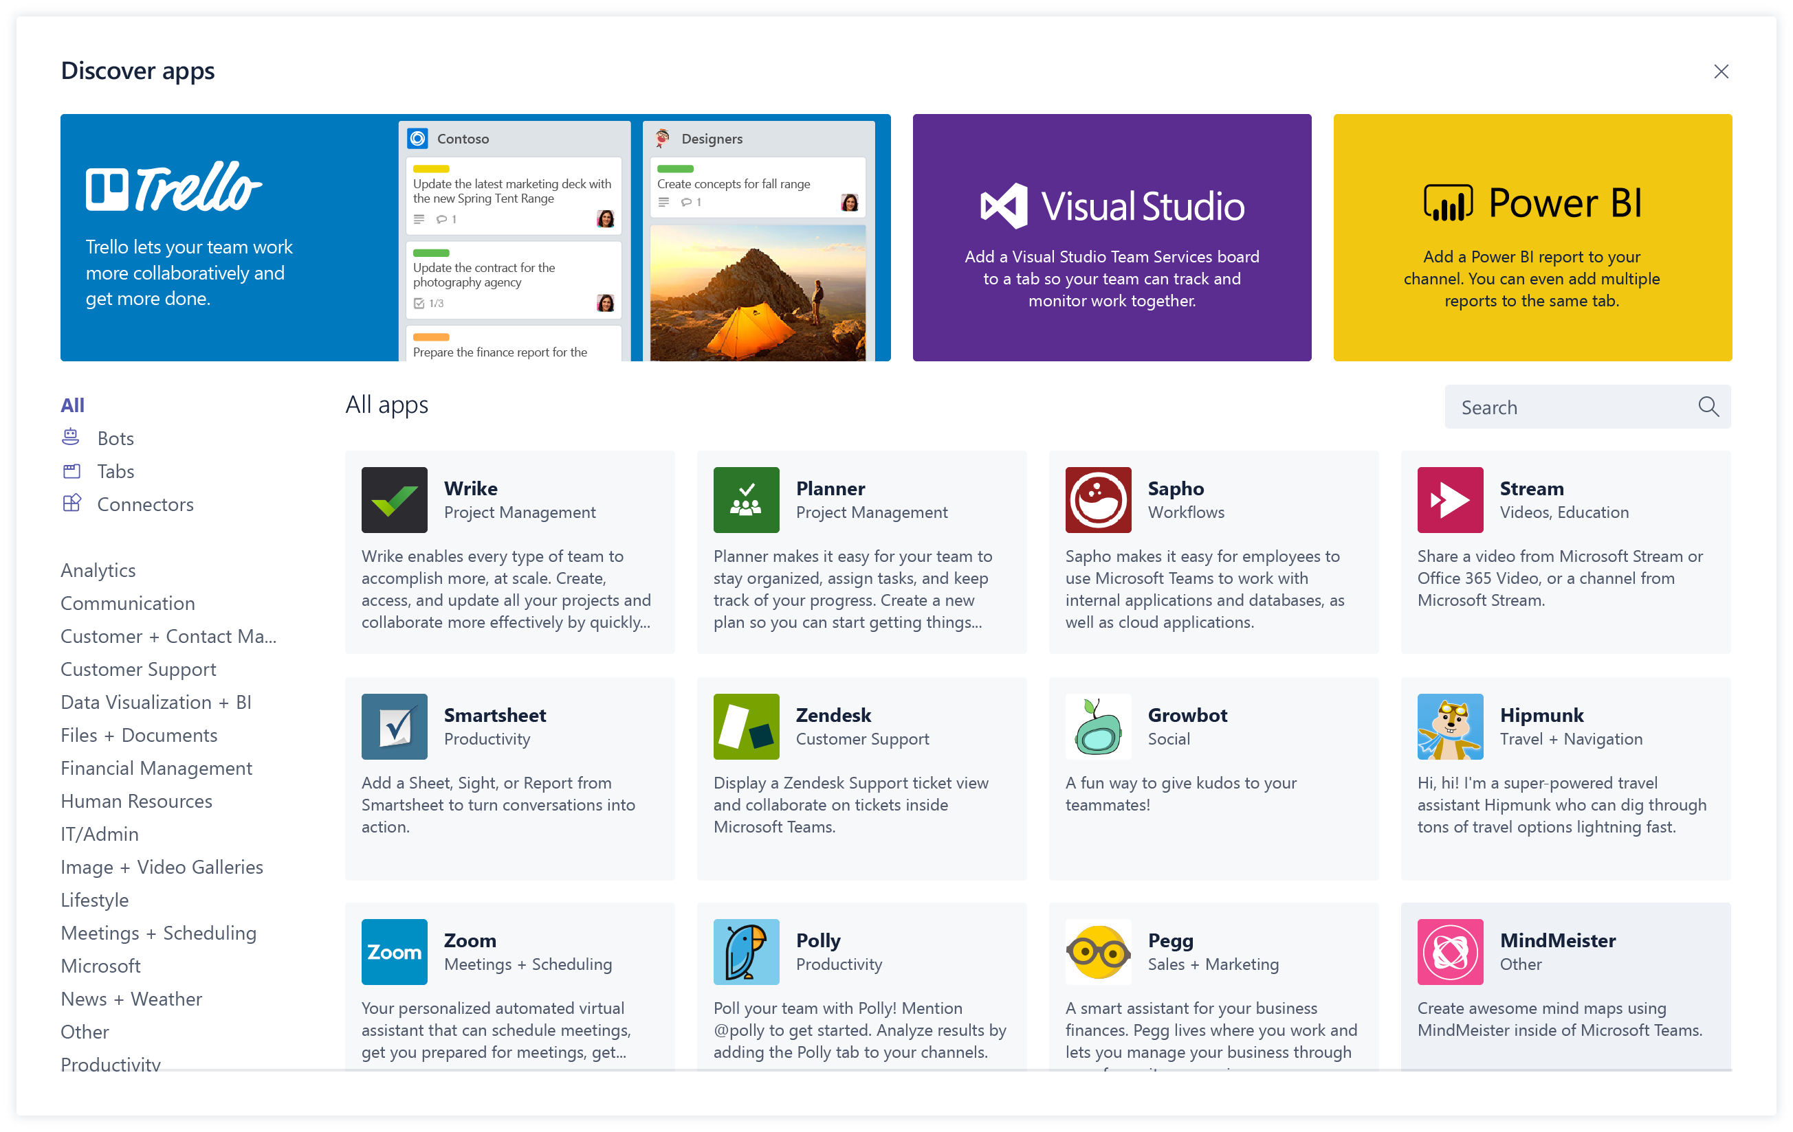
팀즈 탭 만들기 개요
먼저 탭을 디자인하고
필요한 앱 기능들을 고릅니다
사용자에게 기능을 제공할 방법을 고민합니다.
구현을 위한 최소한의 권한을 주고 연동합니다.
나만의 탭을 개발해서
HTML/JavaScript/TypeScript
REST services
Deep Linking and context
만든 탭을 배포하세요
사이드로드 방식으로 배포합니다.
오피스 스토어에 게시합니다.
Notes:
Design
Focused functionality
Tabs work best when they’re built to address a specific need. Focus on a small set of tasks or a subset of data that’s relevant to the channel the tab is in.
Reduced chrome
Avoid creating multiple panels in a tab, adding layers of navigation, or requiring users to scroll both vertically and horizontally in one tab. In other words, try not to have tabs in your tab.
Integration
Find ways to notify users about tab activity by posting cards to a conversation, for example.
Conversational
Find a way to facilitate conversation around a tab. This ensures that conversations center on the content, data, or process at hand.
Streamlined access
Make sure you’re granting access to the right people at the right time. Keeping your sign-in process simple will avoid creating barriers to contribution and collaboration.
Develop
Any editor
Call any service
Deploy
Seller Dashboard is used to submit to store
Not necessary for tabs – can sideload

Slide 4
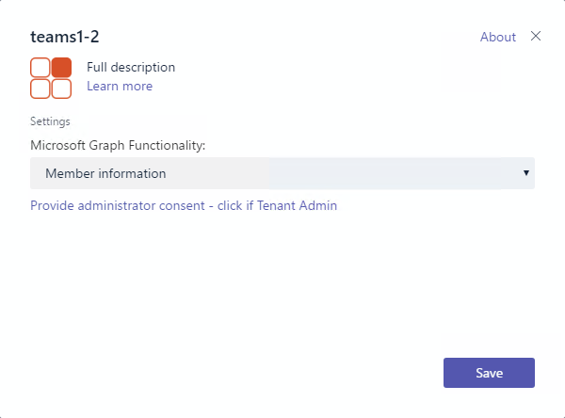
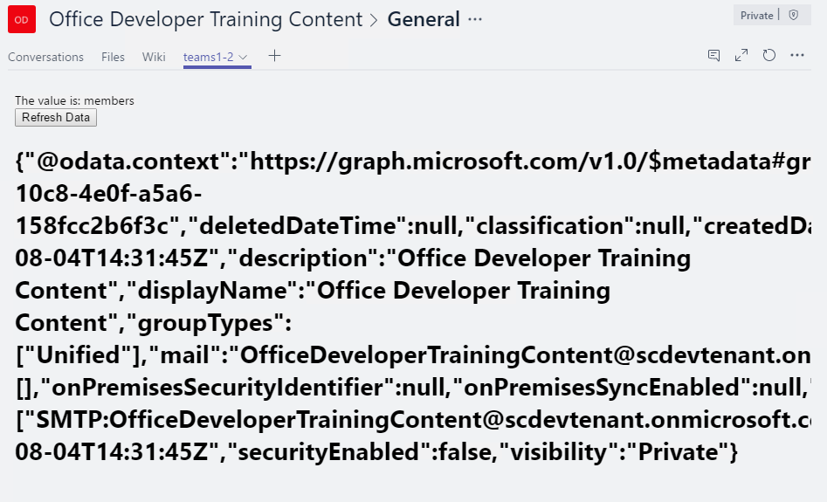
탭 설정과 컨텐츠
탭 설정
manifest 파일을 통해 설정
탭을 채널에 추가할 때 보여짐
정보를 수집하기 위한 목적
Call setSettings() specifying Content Url and Entity Id
탭 컨텐츠
사실상 IFRAME 을 렌더링 함
설정페이지에서 지정된 Url 사용
Inspect context for EntityId/SubEntityId
Retrieve state based on Entity/SubEntity/User
Notes:
To provide a seamless tab experience, perform provisioning and authorization on configuration page when possible.
If context has entity/subentity, then respond to a deeplink
State storage is developer’s responsibility

Slide 5
마이크로소프트 팀즈와의 인터랙션
팀즈 API는 User / Team / Organization에 대한 컨텍스트를 제공합니다.
Getting Context through URL placeholders
Placeholders specified in URL in manifest
Resolved at runtime
Placeholders for each property of Context object
{upn}, {teamId}
Getting Context through the JavaScript library
Library provides function to get context
microsoftTeams.getContext()
Asynchronous method with only success callback
Returns context object
Property | Description
teamId | The team ID in the format 19:[id]@thread.skype
channelId | The channel ID in the format 19:[id]@thread.skype
Locale | Lowercase lang-locale
theme | default | dark | contrast
entityId | The entity id you set up on your config page
subEntityId | The sub entity id you set up on your config page
upn | The user identifier in email format
tid | Guid identifying the current Tenant ID
groupId | Guid identifying the current O365 Group ID

Slide 6
외부 서비스와의 인터랙션
Authenticating
Authentication cannot occur in IFRAME
Teams JavaScript library facilitates popup and cross-window communication microsoftTeams.authentication.authenticate({ url: <auth URL>, width: <width>, height: <height>, successCallback: <successCallback>, failureCallback: <failureCallback>})
In <auth URL> signal result and pass data microsoftTeams.authentication.notifySuccess(token) microsoftTeams.authentication.notifyFailure(err)
Redirecting across domains
Tabs can only show pages in validDomains list of manifest
Call microsoftTeams.navigateCrossDomain(yourNewUrl) to request the IFRAME containing your page is redirected to the specified URL.
(Could also display page in popup via authenticate)

Slide 7
데모 탭에서 마이크로소프트 그래프 API 호출하기

